Slide 1
Capital Infinity
Team 3
Notes:
Sabrina

Slide 2

Meet the Team
Kortney Evans
Iban Gonzalez-Mullady
Andrea Carreras
Noah Gallego
Layla Dent
Kaitlyn Ellis
Jalen Gourrier
Andrea Garcia Mata
Sabrina Niño
Paris Garrett

Slide 3
Agenda
Problem Statement
Executive Summary
Overview
Calculations
Customer Segment
Recommendations
Risk and Mitigation
App Demonstration
Conclusion
Notes:
Andrea G:

Slide 4
Problem Statement

Slide 5
Problem Statement
Capital One came to us asking if they should keep and improve their 10k credit line or release a new 20k credit line product.
Notes:
Andrea C:

Slide 6
Executive Summary

Slide 7
Executive Summary
Problem:
We identified that the current $10,000 credit line is sufficient to attract users who desire higher credit limits. This represents an opportunity to engage more high-value customers.
Findings:
Our analysis shows that the current $10,000 product is profitable, with a profit of $120 per account, totaling $12 million annually.
We explored the potential of a $20,000 credit line. Initial testing indicates a lower profit per account of $60 with an $8,000 utilization, requiring more accounts to achieve the same total profit.
Recommendation:
Based on these findings, we recommend launching the $10,000 credit line. This will not only attract users seeking higher limits, but it also enhances customer satisfaction and boosts our profitability.
Notes:
Jalen:

Slide 8
Overview
Notes:
layla

Slide 9
Overview of the company
Year founded: 1994
Core Value: Excellence and Do The Right Thing
Current Market: Financial Services
2023 Revenue: $36.8 Billion
# of Employees: 51,987
Product Demographic:
Our credit card is appealing to Super Prime Customers
Highest credit bureau's score range
720+ credit score
Most likely credit group to repay debts
Market Analysis
Current Market Share: 9.83%
Top Competitors & Their Outstanding Share of Balances: Chase (16.54%), American Express (12.36%), Citi (11.56%) and Bank of America (9.92%)
S.W.O.T Analysis
Strength: Innovative Technology
Weakness: Relatively New
Opportunities: Market Share Growth
Threats: Competitors and High Interest Rates
Notes:
Layla:
Capital One Financial annual revenue for 2023 was $49.484B, a 28.96% increase from 2022. Capital One Financial annual revenue for 2022 was $38.373B, a 19.79% increase from 2021. Capital One Financial annual revenue for 2021 was $32.033B, a 1.23% increase from 2020.
https://www.macrotrends.net/stocks/charts/COF/capital-one-financial/revenue#:~:text=Capital%20One%20Financial%20annual%20revenue,a%201.23%25%20increase%20from%202020.

Slide 10
The Calculations
Notes:
layla

Slide 11
The Code:
# Interest Revenue def calculate(product): # Extracting values from the dictionary creditLine = product["creditLine"] utilization = product["utilization"] interestRate = product["interestRate"] annualFee = product["annualFee"] annualOpsCost = product["annualOpsCost"] fundingCost = product["fundingCost"] chargeOff = product["chargeOff"] bookings = product["bookings"] remainingBalance = product["remainingBalance"] # Revenue revenuePerAccount = creditLine * utilization * interestRate # Credit Line * Utilization * Annual Interest Rate revenuePerAccount += annualFee # Add Annual Fee totalRevenue = revenuePerAccount * bookings # Multiply by Annual Bookings # Loss numberOfCustomersWhoArentPaying = chargeOff * bookings # Number of customers who don't pay loss = numberOfCustomersWhoArentPaying * remainingBalance # Loss from customers who don't pay their balance loss += fundingCost * utilization * creditLine * bookings # Funding Cost = Funding Cost Rate * Utilization * Credit Line * Bookings loss += annualOpsCost * bookings # Add Annual Ops Cost # Profit profit = totalRevenue - loss # Profit = Total Revenue - Total Loss return profit

Slide 12
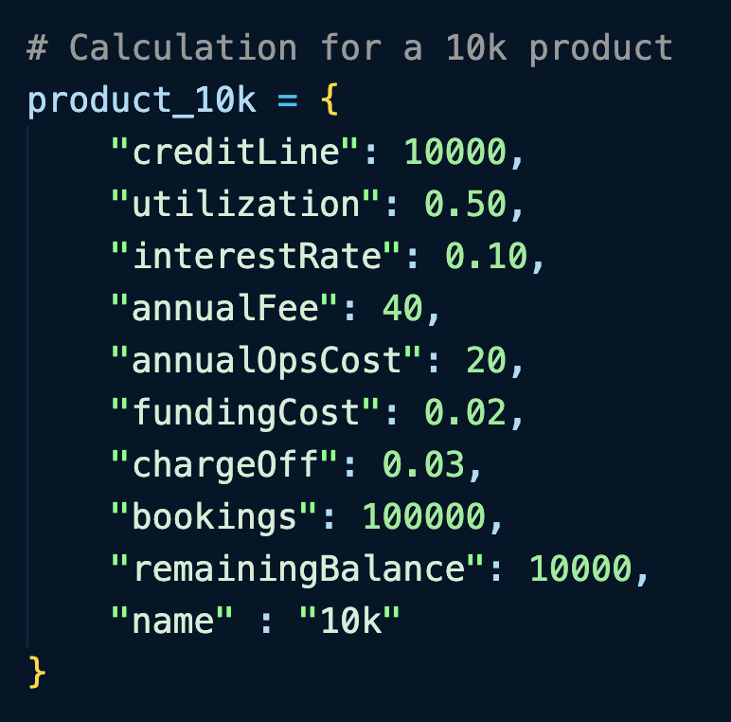
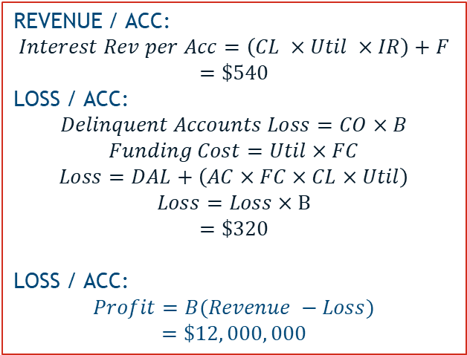
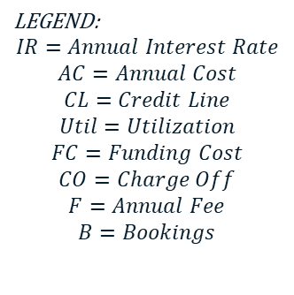
Question One Evaluate whether or not to update the current product offer. How would you go about making this decision? Is the current 10k product profitable?
To evaluate all of our math, we created a profit calculator in Python. The economics given were tested on the 10k product for profitability. (Results Below)
LEGEND:
$$IR=Annual Interest Rate$$
$$AC=Annual Cost$$
$$CL=Credit Line$$
$$Util=Utilization$$
$$FC=Funding Cost$$
$$CO=Charge Off$$
$$F=Annual Fee$$
$$B=Bookings$$
REVENUE / ACC:
$$Interest Rev per Acc=\left(CL ×Util ×IR\right)+F$$
$$=\$540$$
LOSS / ACC:
$$Delinquent Accounts Loss=CO×B$$
$$Funding Cost=Util×FC$$
$$Loss=DAL+\left(AC×FC×CL×Util\right)$$
$$Loss=Loss×B$$
$$=\$320$$
LOSS / ACC:
$$Profit=B(Revenue −Loss)$$
$$=\$12, 000, 000$$
Notes:
Noah:

Slide 13
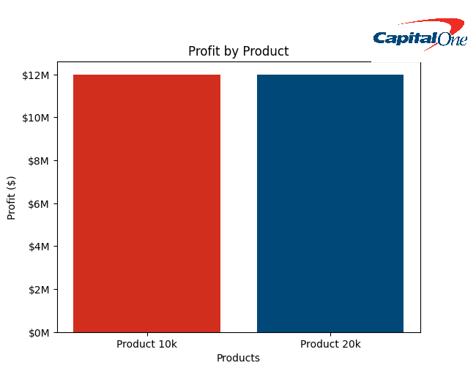
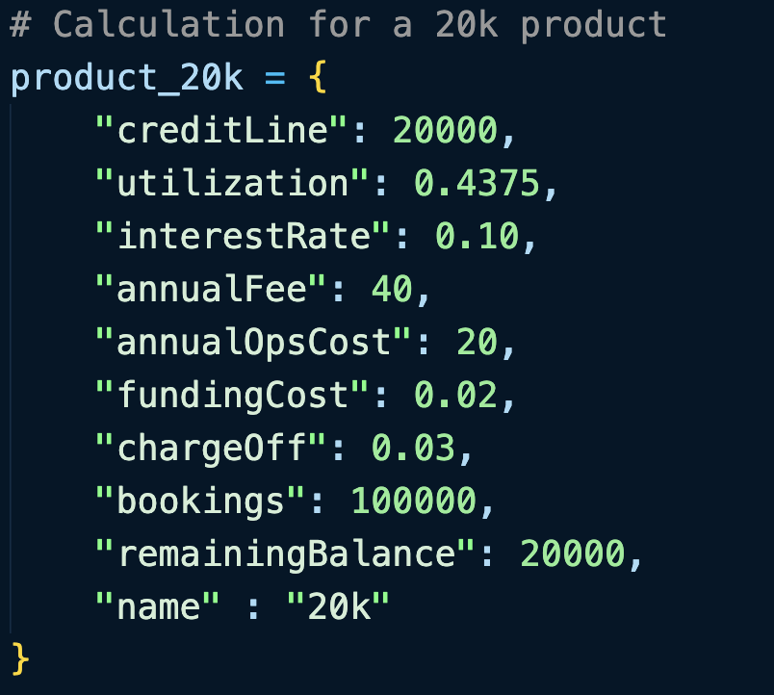
Question Two What would utilization need to be with the 20k line product in order to make the same amount of profit as the 10k line profit, assuming everything else stays the same?
LEGEND:
$$IR=Annual Interest Rate$$
$$AC=Annual Cost$$
$$CL=Credit Line$$
$$Util=Utilization$$
$$FC=Funding Cost$$
$$CO=Charge Off$$
$$F=Annual Fee$$
$$B=Bookings$$
To evaluate all of our math, we solved mathematically, and verified with our Python calculator.
Notes:
Noah:

Slide 14
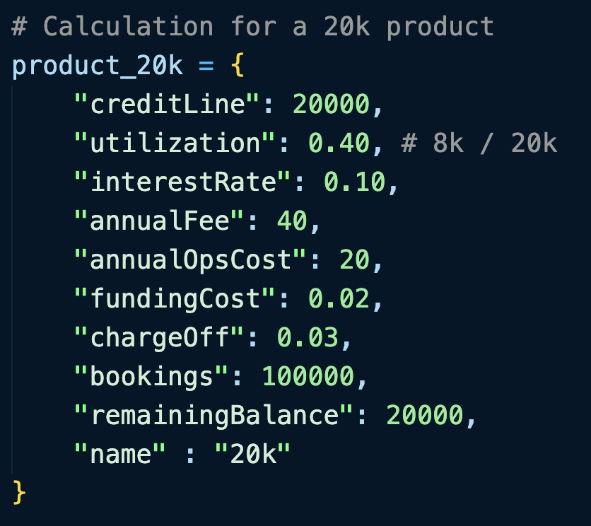
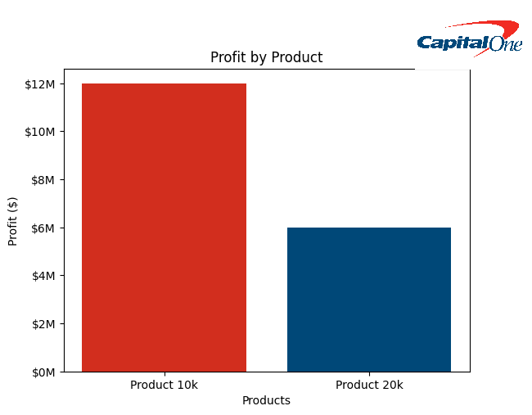
Question Three Initial testing showing that for the 20k line, balance is coming in at $8000, would you recommend launching the 20k product?
To evaluate the problem, we solved with our calculator. The calculator clearly shows that the 10k makes exactly two times the profit as the 20k product. So, in this case we would not because of profitability.
LEGEND:
$$IR=Annual Interest Rate$$
$$AC=Annual Cost$$
$$CL=Credit Line$$
$$Util=Utilization$$
$$FC=Funding Cost$$
$$CO=Charge Off$$
$$F=Annual Fee$$
$$B=Bookings$$
QUESTION 4: Furthermore, to see how many accounts (bookings) would be needed to let the profit of the two products equal, we were able to recall that the 10k is two times the profit as 20k, allowing us to deduct we need to scale the bookings by a factor of two. This gave us 200,000 bookings.
Notes:
Noah:

Slide 15
Customer Segment

Slide 16



Super Prime Customer Base
Average Income
Over $100,000
Super Prime Customer
Average Age
From 40-70
Average amount of debt
$1,000
Notes:
Sabrina:
Average Income:
Age – since the average super prime customer is in the age range of 40-70 we decided to focus our credit card offerings on this group
Average Amount of Debt:
Super-prime customer holds an average of $1,000 in debt which is $900 lower than prime customers who are the tier below super-prime customers.

Slide 17
Recommendations
Notes:
Paris
-Since 2022 Capital one achieved a ten plus percent increase in annual annually and I’m sure everyone would like for that trend to continue.

Slide 18
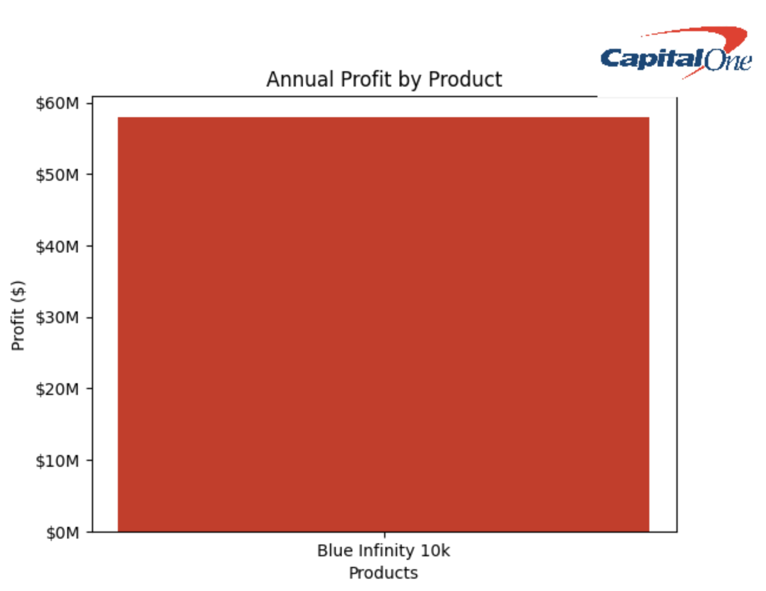
Recommendations
Recommendations
Blue Infinity $10k:
Annual Profit: $58M
Profit Per Customer: $80
Credit Line: $10k
Bookings: 100k
Utilization: 50%
Interest Rate: 20%
Annual Fee: $0
With super primes being relatively rare, the question became how best to diversify our product offering amongst this group?
Notes:
Paris:
-With super primes being relatively rare, the question became how best to diversify our product offering amongst this group? After much analysis, we decided that the best way to do so is by enticing a wider array of customers to upgrade RESPONSIBLY.

Slide 19
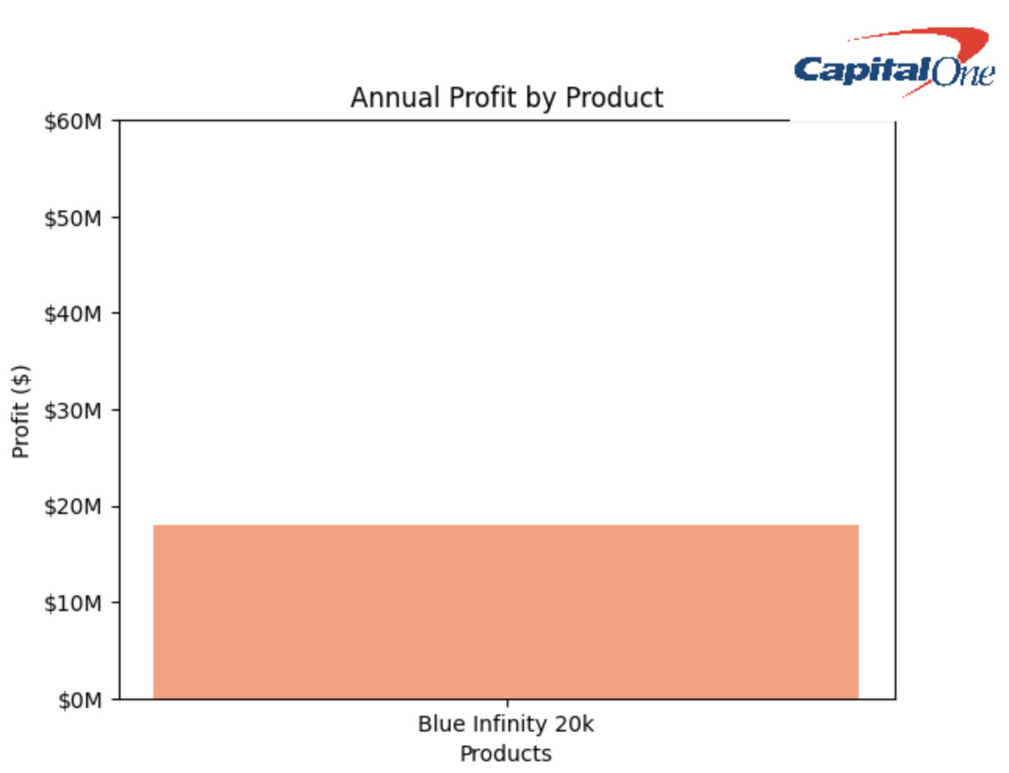
Recommendations
Recommendations
Blue Infinity $20k:
Annual Profit: $18M
Profit Per Customer: $580
Credit Line: $20k
Bookings: 100k
Utilization: 50%
Interest Rate: 10%
Annual Fee: $0
We suggest this be achieved by eliminating annual fees, offering rewards, and only increasing a customer's credit limit after they can display 6 consecutive months of good credit/payment history, ​
Notes:
Paris:
-We suggest this be achieved by eliminating annual fees, offering rewards, and only increasing a customer's credit limit after they can display 6 consecutive months of good credit/payment history,
https://www.macrotrends.net/stocks/charts/COF/capital-one-financial/revenue#:~:text=Capital%20One%20Financial%20annual%20revenue,a%201.23%25%20increase%20from%202020.

Slide 20
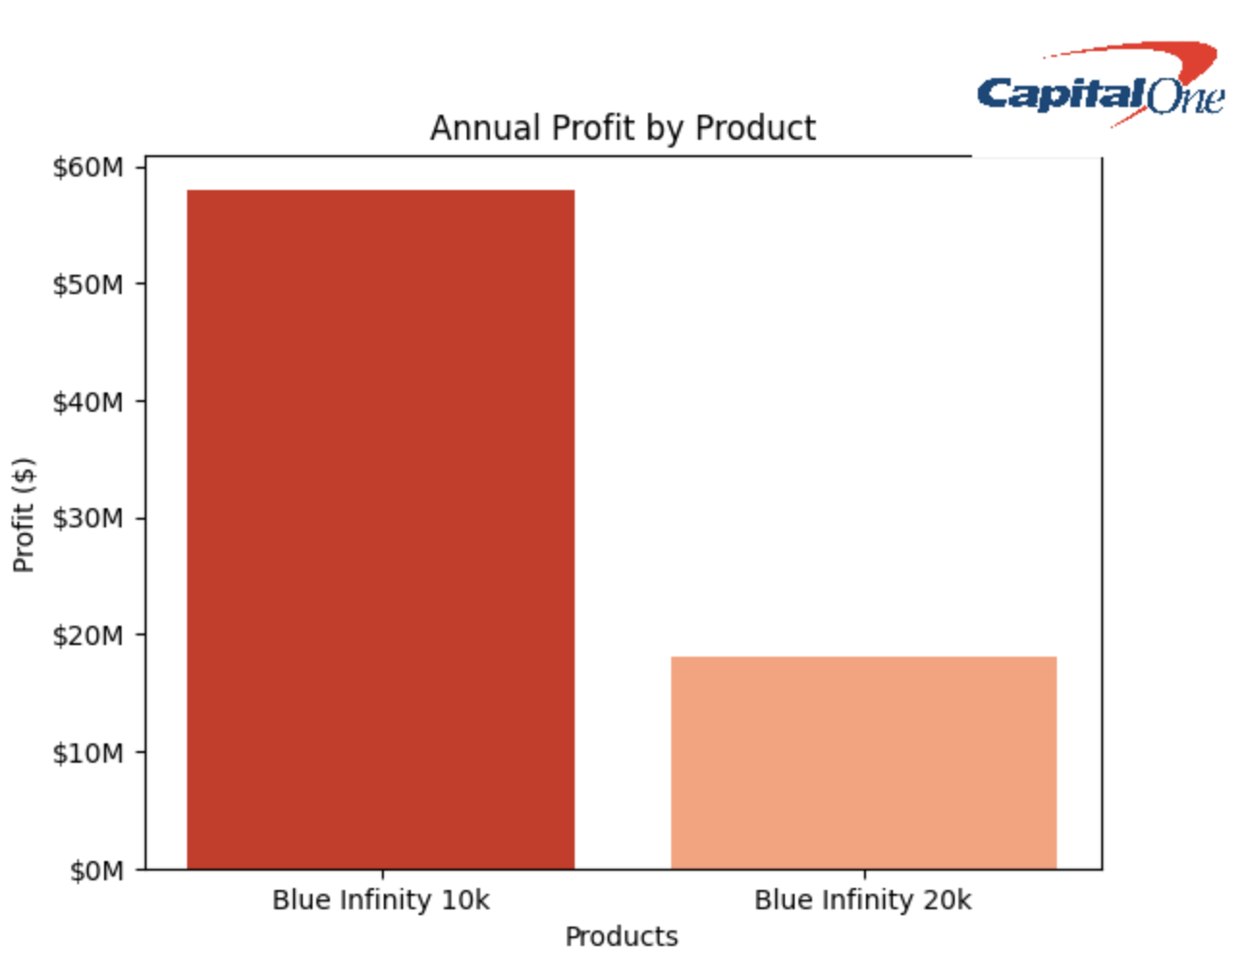
Recommendations
Final Recommendation
Blue Infinity $20k:
Annual Profit: $18M
Profit Per Customer: $580
Credit Line: $20k
Bookings: 100k
Utilization: 50%
Interest Rate: 10%
Annual Fee: $0
Blue Infinity $10k:​
​​
Annual Profit: $58M ​​
Profit Per Customer: $80 ​​
Credit Line: $10k​​
Bookings: 100k ​​
Utilization: 50% ​​
Interest Rate: 20%​​
Annual Fee: $0
This graph depicts both ends of the $10k/$20k product spectrum, while keeping in mind both profitability and diversification.
Notes:
Paris:
-This graph depicts both ends of the $10k/$20k product spectrum, while keeping in mind both profitability and diversification.

Slide 21





The Capital Blue Infinity Card
10 - 29% Variable APR
Fraud Protection
Initial Access to 10k Line
Future Access to 20k Line Upon excellent payment history

Slide 22
Additional Offerings
Travel Rewards
Complimentary access to premium airport lounges worldwide
Cashback
Elevated cashback rates on categories like dining, groceries, and online shopping
Free or discounted subscriptions to premium streaming services to target a younger audience
Streaming Services
Notes:
Sabrina:
We believe these perks could be best to add to our credit card, but we need to test which perks most resonate with our customers, and which give us the most dollar to spending dollar.
These are some of the offerings we will be testing out. Using the metrics we found in our research we found that these offerings would appeal most to the target super prime audience. These offerings will be presented to our customers on a rotating basis to ensure that the most benefit to our customers

Slide 23



Risk Model
Payment history
Amount owned
Length of credit history
Capital One credit history
Credit mix
Approved
6 months
Disapproved
Notes:
Iban:
Every 6 months, a risk checker will evaluate all the risk associated with increasing credit lines and see which credit card users can be approved for an upgrade to a 20k limit.

Slide 24
Risk and Mitigations

Slide 25

Risk and Mitigation
Higher loss from 20k delinquent accounts
Periodic Credit Checks
Less Profit for 20k Accounts in General
Verified & Completed Six Months Payment History
Less Profit from Annual Fee
Increased interest rates to cover expenses
Notes:
Courtny:

Slide 26
Implementation and Deployment
Implementation:
Agile Methodology
Agile focuses on adaptability and customer satisfaction through continuous feedback
Deployment:
Deployment can involve many steps, including testing, configuration management, and release management.
Big Bang deployment strategy refers to an all-at-once approach
Month 1-4: Research & Development
Month 4-6: Planning
Month 6-10: Developing
Month 11: Product Release
Month 13: System Maintenace
Month 14 + Post Op. Check up
Staffing Needs:
Project Managers: Develop a realistic project schedule and follow it
Research and Development: To research best practices
Software Engineers: To design the product and test for functionality
Finance Manager: Analyze costs in order to ensure the project will not overspend
Cybersecurity: To have our customers and our information secured
Notes:
Capital One Financial annual revenue for 2023 was $49.484B, a 28.96% increase from 2022. Capital One Financial annual revenue for 2022 was $38.373B, a 19.79% increase from 2021. Capital One Financial annual revenue for 2021 was $32.033B, a 1.23% increase from 2020.
https://www.macrotrends.net/stocks/charts/COF/capital-one-financial/revenue#:~:text=Capital%20One%20Financial%20annual%20revenue,a%201.23%25%20increase%20from%202020.

Slide 27
App Demonstration

Slide 28
Recommendations
Conclusion
Our final recommendation is for Capital One to implement the10K credit line
Notes:
Andrea:
In closing, we'd just like to reiterate that our recommendation is to go with the $10k Blue Infinity product. Higher loss from $20k delinquent accounts, less profit for $20k accounts in general. -Periodic credit checks, verifying 6 months of credit checks and payment history

Slide 29
Questions?

Slide 30
Appendix

Slide 31
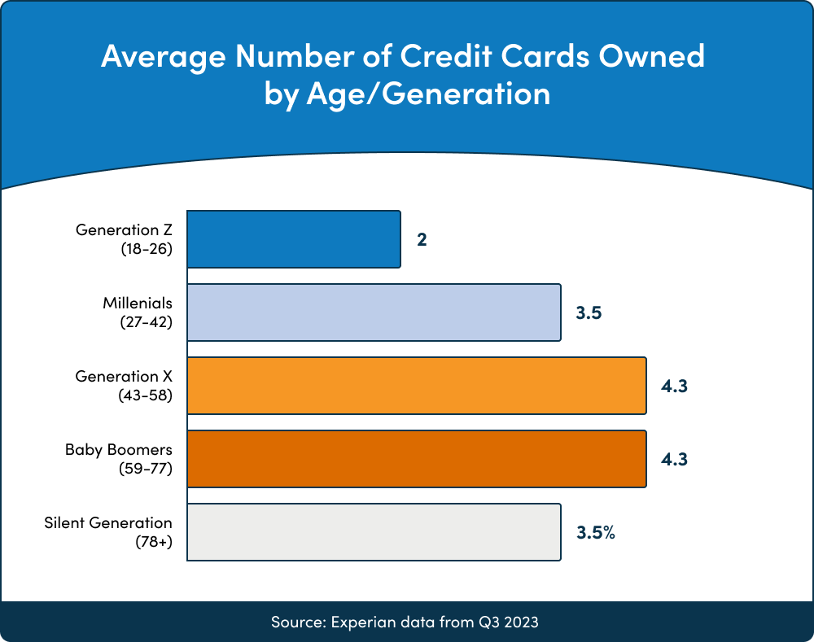
Super Prime Customer Base Appendix
https://upgradedpoints.com/credit-cards/credit-card-ownership-statistics/
“Credit Card Ownership by Income
Income levels have a significant impact on card ownership. Among households with an annual income of over $100,000, 97% have a credit card. Those making between $50,000 and $100,000 annually still have a high percentage of credit card ownership at 89%. Once the household income drops below $25,000, however, credit card ownership drops steeply to 46%”

